Slide 1
Silk Road
By Nick Middleton

Slide 2
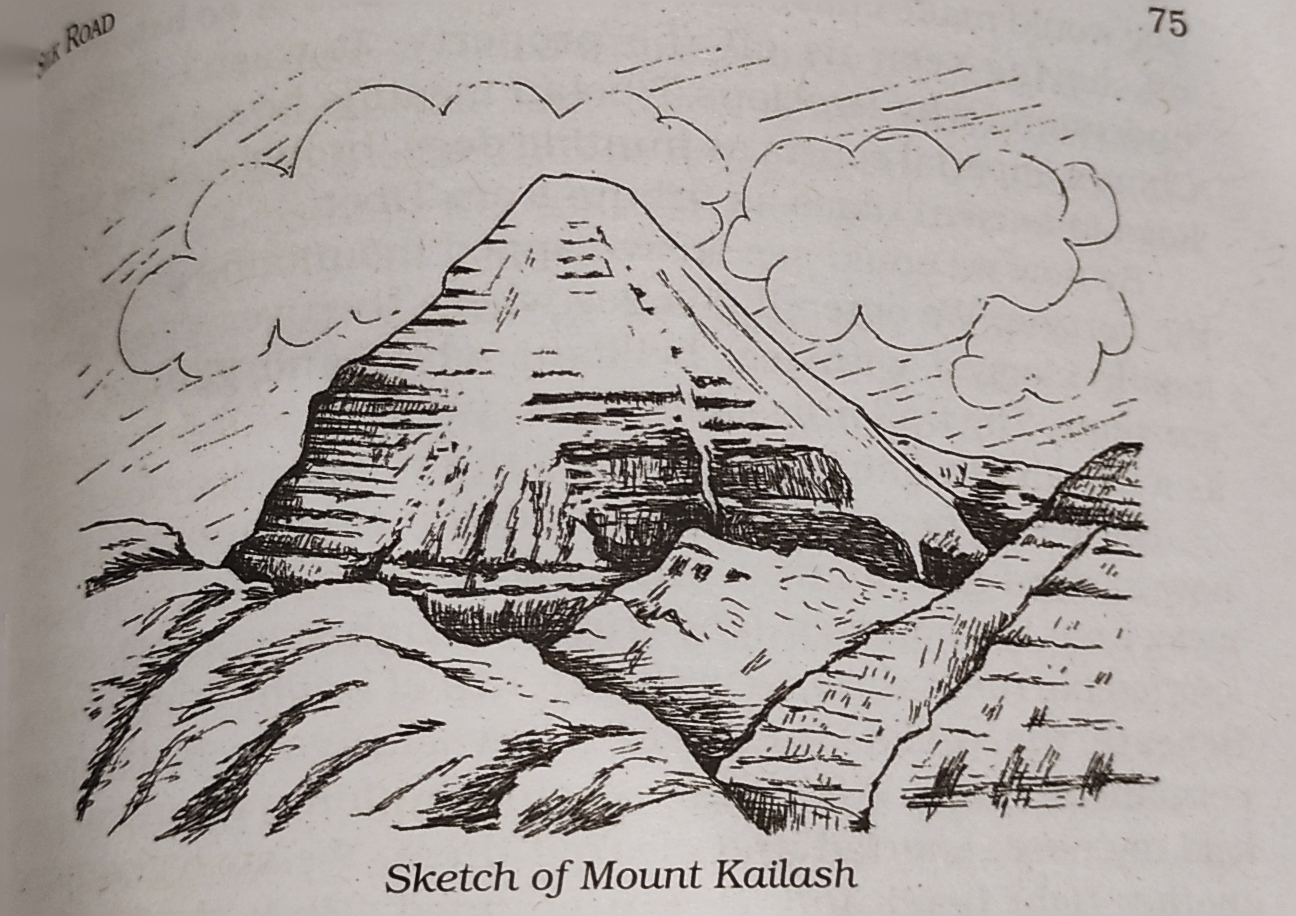
The author wanted to go to Mount Kailash to complete the kora. He hired Tsetan to drive him up to Mount Kailash. As a farewell gift, Lhamo gave him a long-sleeved sheepskin coat. He took Daniel as his companion till Darchen.
When they started the journey, Tsetan took a short cut to the south-west which was a direct route to Mount Kailash. They had to cross high mountain passes to reach their destination.
Tsetan assured him that it would be no problem if there would be no snow. They crossed through few gazelles, a herd of wild asses and shepherds tending the flocks.

Slide 3
When they reached the hill, they passed dark tents which were home for nomads. He saw a Tibetan mastiff standing outside the tent as a guard. These mastiffs ran after his car as he reached near the tents. These dogs had large jaws.
As soon as they entered the valley, they witnessed snow capped mountains with rivers flowing which were blocked with ice. When they were riding through the hill, the turns became sharper and roads became bumpier.
Tsetan was driving in third gear. The author could feel the pressure in his ears. He held his nose, snorted to clear the congestion. He checked his wristwatch, they were at 5210 meters above sea level.
They reached their first hurdle which was a road filled with snow. Tsetan threw dirt on the snow and drove carefully on that road. They resumed their journey. The author felt his head was hurting.

Slide 4
He took a few sips of water from his water bottle. They were still climbing up the hill. They reached at 5515 meters above sea level. They stopped again and this time the fuel tank hissed when Tsetan unscrewed the top.
As the petrol was expanding due to low atmospheric pressure, Tsetan told them not to smoke around it. Soon in the afternoon around two o clock, they stopped for lunch. The author’s headache was gone by now.
By late afternoon, they reached a small town called ‘Hor’. They reached the east-west highway again. It was the old route from Lhasa to Kashmir. Daniel got off the car and took a lift to Lhasa. Their car had a few punctures which worried Tsetan.
He got them fixed and the author waited at a local café of Hor while having a glass of tea. He found Hor a miserable place. After a while, Tsetan reached to him and they resumed their journey again.

Slide 5
At night around 10.30 pm, they stopped at a guest house in Darchen to spend the night. The author got ill and suffered from nose-congestion due to the change in altitude and cold weather. He stayed awake all night.
Next morning, Tsetan took him to Tibetan medical college where a he consulted a Tibetan Doctor who gave him a five-day course medicines in a brown envelope. After taking a full day of medicine, the author was feeling good.
Tsetan left him thereafter assuring his health condition. The author was staying at Darchen. That place had a general store where Chinese cigarettes, soap, and other things were available.
In the afternoon, the men gathered at a shabby table to play pool every day. Women would wash their hair in the narrow stream. Darchen had one problem, it had no pilgrims. According to the local people, in the peak season of pilgrimage the place would be filled with travelers.

Slide 6
He met a person in the Darchen’s only café. His name was Norbu who was a Tibetan working in Beijing at the Institute of Ethnic Literature of Chinese Academy of Social Science. He came to Darchen to complete the kora just like the author.
He was fat and found it difficult to walk. The author decided to go on the pilgrimage with him. They hired yaks to carry their luggage. Norbu finally said it is not possible for him while he collapsed across the table and laughed hilariously. His tummy was also too big.

Slide 7
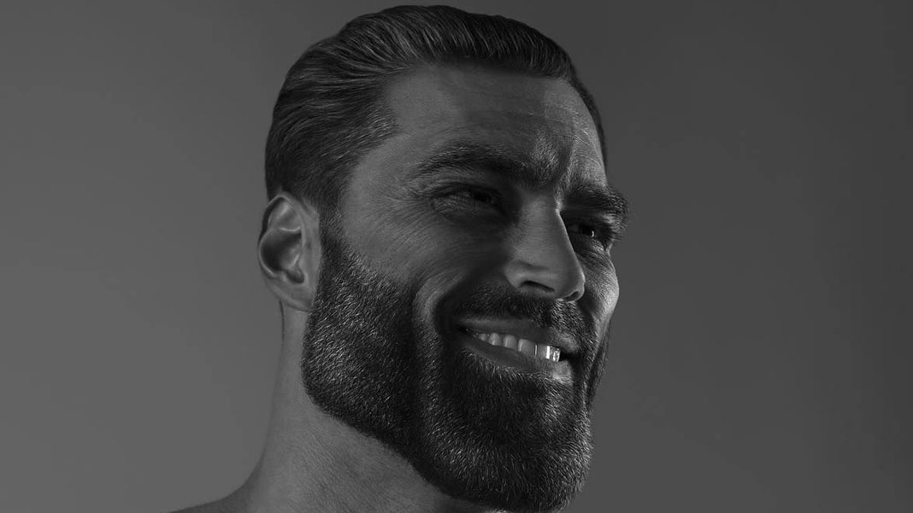

Thank you ;)
pptx by Tariq
11-D

